Slide 1



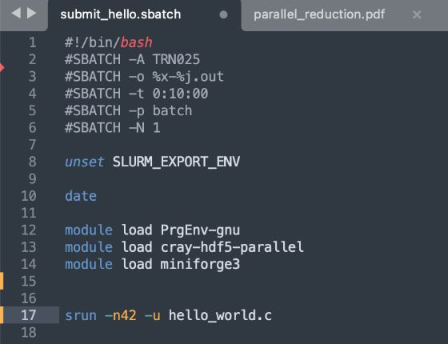
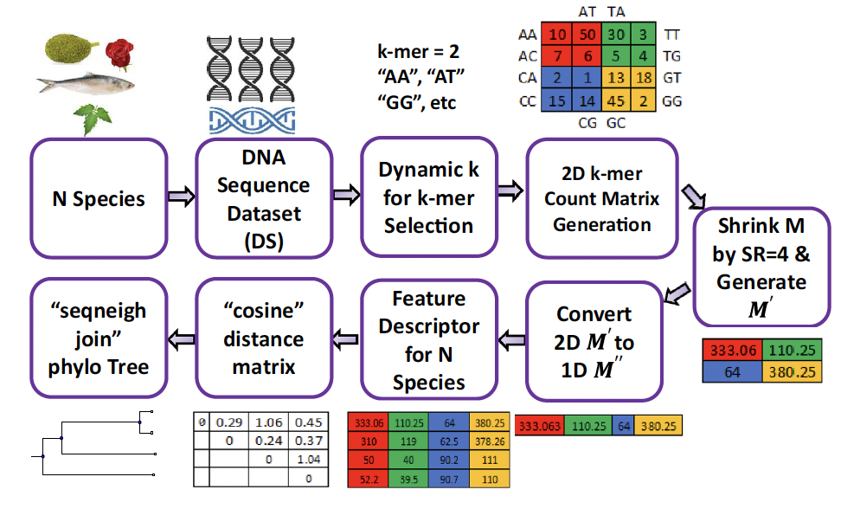
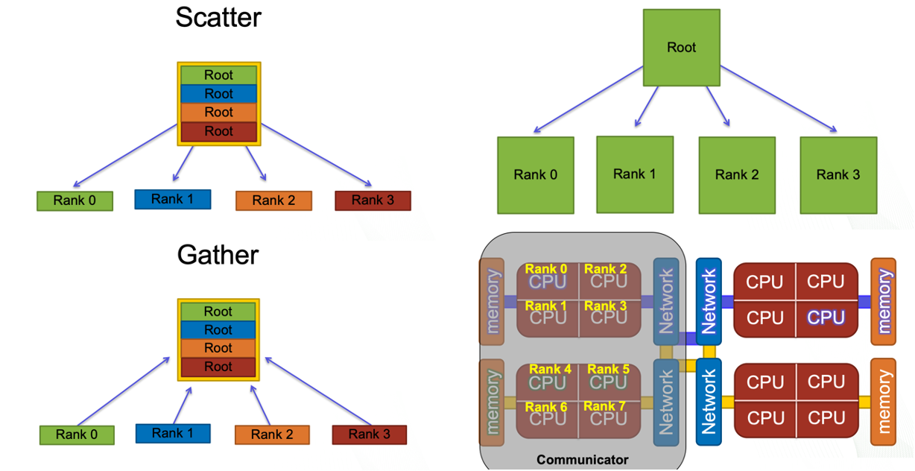
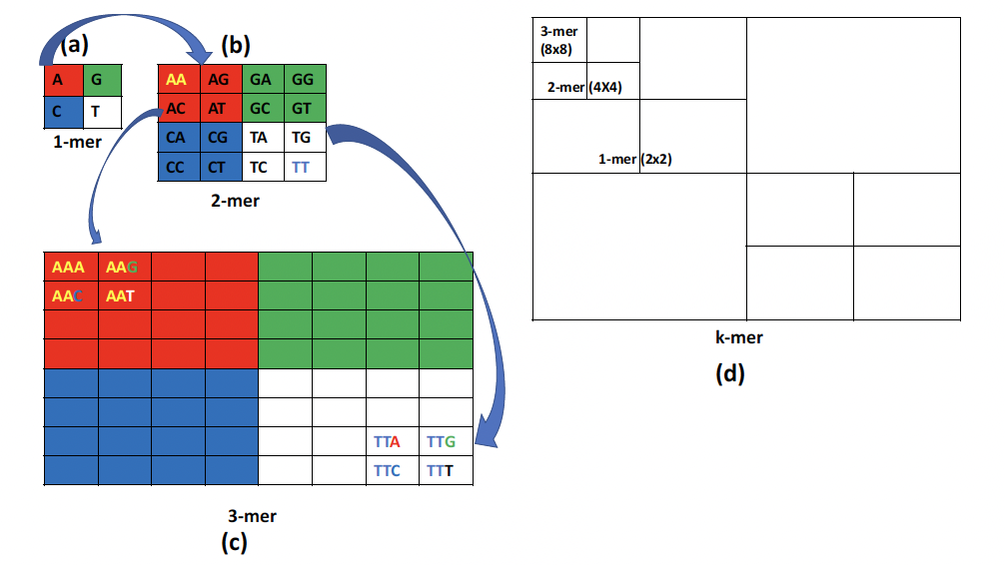
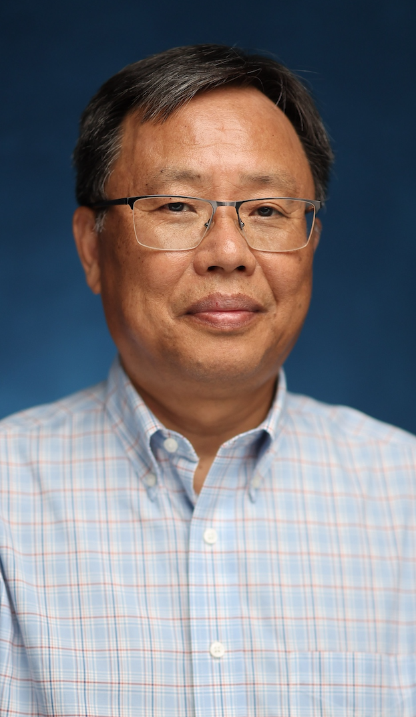
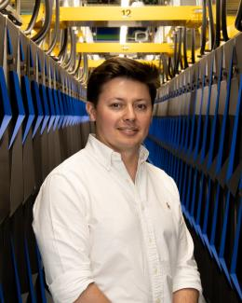
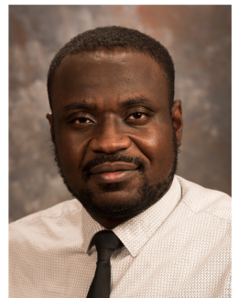
Curriculum enhancement of the Parallel Computing course at Jackson State University.
SGX3 award # 2231406
Revised Course Description
Sample HPC/Gateways Exercise
Gateway Community Mentor Syllabus Suggestions
This course (CSC 425) is for junior to senior Computer Science (CS) and Computer Engineering (CE) students. Based on the curriculum, all students should have already finished programming languages, operating systems, computer architectures, and data structure courses to develop sequential programs. The course, will focus on implementing parallel algorithms. The topics of the course include programming languages with libraries such as OpenMP, MPI, and OpenACC.
The programming models consist of several subareas:
Data parallelism
Task parallelism
Multithreaded programming
Shared memory model
Message-passing model
These projects require a large space for large data sets and computing power. As part of this effort, some of the NSF/IEEE-TCPP curriculum initiatives on Parallel and Distributed Computing (PDC) modules were integrated into department-wide core and elective courses offered in both fall and spring semesters. From CSC 325 Operating Systems (core), the students learn how to write simple parallel programs with the POSIX threads library.
Genomics Big Data Problem:
The simple DNA problem:
DNA sequences are represented as character strings, with each character representing a nucleotide type. The DNA sequence alignment problem, or pattern searching problem, identifies coincidences of nucleotide strings in a long DNA sequence. Multiple pattern matching is a complex problem in a DNA sequence. Our assignment addresses this by finding matches in a random main DNA sequence with multiple nucleotide patterns, which can also be random sequences or exact copies of parts of the main sequence. The students are going to use a brute-force algorithm that checks each pattern at every possible position in the DNA sequence, offering parallelization opportunities. The program identifies patterns found in the sequence and their starting positions. The project requires the implementation of direct parallelization opportunities at two levels: patterns and starting positions.
Several changes were suggested, including:
Add basic Linux and command line content to introduce HPC clusters in the course.
Remote connection to the HPC cluster using SSH.
Sending jobs to supercomputer using SLURM.
VIM usage for text edition.
Move from CUDA to OpenACC to be able to use any kind of GPU accelerator.
Datasets
BAM format DNA sequence
BAM format target DNA sequency- must a short.
Or Patterns of DNA
Dataset for PCA
Possible Expansions
Develop program that can generate patterns and locations.
Resources / Science Gateways
Authors
Symmetric multiprocessing (SMP) type HPC for OpenMP
Pathways For Supercomputing
ACCESS
Globus for data transfers
Author
Photo
Sungbum Hong
Jackson State University
sungbum.hong@jsums.edu
Relevant Projects
Resource Needs/List
Use Cases
Implement three parallel algorithms:
Fibonacci computation Algorithms;
Principal Component Analysis (PCA) for Large Data Sets with Parallel Data Summarization;
Parallel algorithm for DNA sequence.
The skills and knowledge to the DNA sequency can be utilized in developing:
plant breeders selection,
contributing to higher crop yields,
disease-resistant crops, and
diagnosing and treating diseases.
HPC/Gateways Mentor
Fernando Posada
Oak Ridge National Laboratory
posadacorref@ornl.gov
Symmetric multiprocessing (SMP) type HPC for OpenMP,
Cluster of computers for MPI
Cluster of Computer with GPUs for OpenAcc
SAMtools and HTSlib on three different types of computing facility.
OpenMP-compatible C compiler, any MPI library.
OpenAcc-comparable C compiler.
HPC/Gateways Mentor
Samuel Fagbemi
Oak Ridge National Laboratory
fagbemisa@ornl.gov
Implementation Schedule
The course is expected to be offered to students next fall 2025.
MORE INFORMATION → https://hackhpc.github.io/facultyhack-gateways23 __

